Slide 1

Problem Solving with C++ by Walter Savitch

Slide 2
Chapter 12
Separate Compilation and Namespaces

Slide 3
Overview
12.1 Separate Compilation
12.2 Namespaces

Slide 4
12.1
Separate Compilation

Slide 5
Separate Compilation
C++ allows you to divide a program into parts
Each part can be stored in a separate file
Each part can be compiled separately
A class definition can be stored separately from a program.
This allows you to use the class in multiple programs

Slide 6
ADT Review
An ADT is a class defined to separate the interface and the implementation
All member variables are private
The class definition along with the function and operator declarations are grouped together as the interface of the ADT
Group the implementation of the operations together and make them unavailable to the programmer using the ADT

Slide 7
The ADT Interface
The interface of the ADT includes
The class definition
The declarations of the basic operations which can be one of the following
Public member functions
Friend functions
Ordinary functions
Overloaded operators
The function comments

Slide 8
The ADT Implementation
The implementation of the ADT includes
The function definitions
The public member functions
The private member functions
Non-member functions
Private helper functions
Overloaded operator definitions
Member variables
Other items required by the definitions

Slide 9
Separate Files
In C++ the ADT interface and implementation can be stored in separate files
The interface file stores the ADT interface
The implementation file stores the ADT implementation

Slide 10
A Minor Compromise
The public part of the class definition is part of the ADT interface
The private part of the class definition is part of the ADT implementation
This would hide it from those using the ADT
C++ does not allow splitting the public and private parts of the class definition across files
The entire class definition is usually in the interface file

Slide 11
Case Study: DigitalTime
The interface file of the DigitalTime ADT class contains the class definition
The values of the class are:
Time of day, such as 9:30, in 24 hour notation
The public members are part of the interface
The private members are part of the implementation
The comments in the file should provide all the details needed to use the ADT

Slide 12
Naming The Interface File
The DigitalTime ADT interface is stored in a file named dtime.h
The .h suffix means this is a header file
Interface files are always header files
A program using dtime.h must include it using an include directive #include "dtime.h"

Slide 13
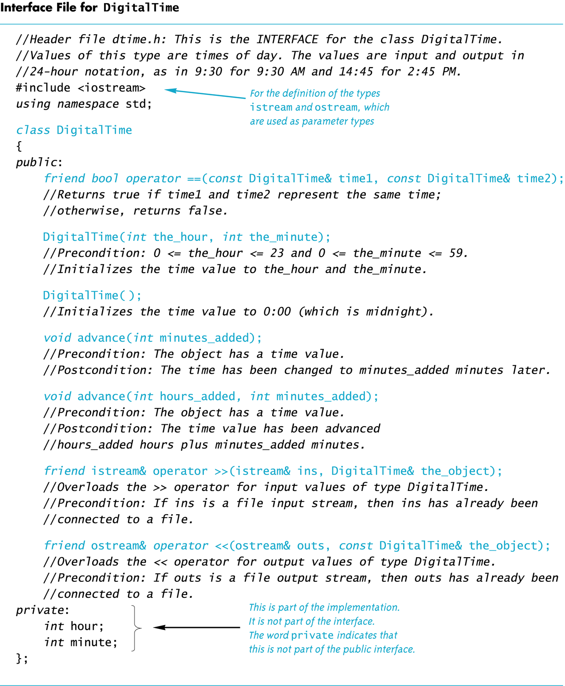
Display 12.1

Slide 14
#include " " or < > ?
To include a predefined header file use < and > #include <iostream>
< and > tells the compiler to look where the system stores predefined header files
To include a header file you wrote, use " and " #include "dtime.h"
" and " usually cause the compiler to look in the current directory for the header file

Slide 15
The Implementation File
Contains the definitions of the ADT functions
Usually has the same name as the header file but a different suffix
Since our header file is named dtime.h, the implementation file is named dtime.cpp
Suffix depends on your system (some use .cxx or .CPP)

Slide 16
#include "dtime.h"
The implementation file requires an include directive to include the interface file: #include "dtime.h"

Slide 17
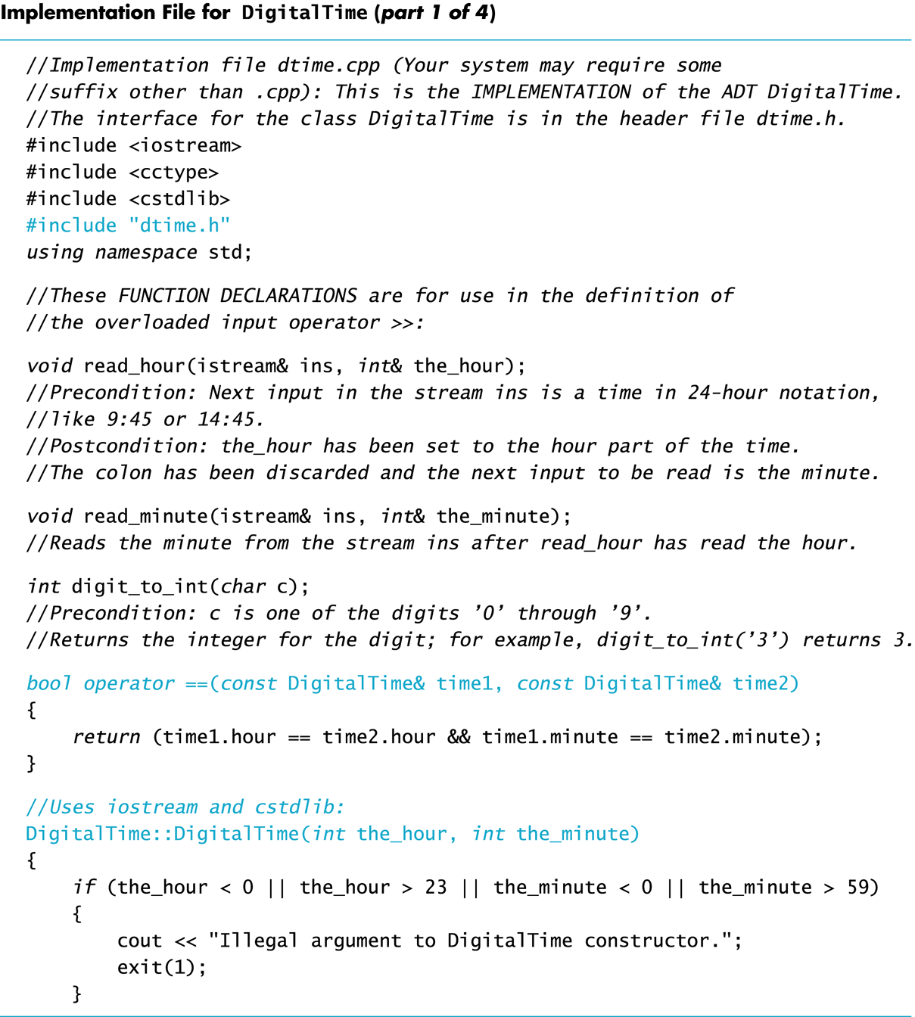
Display 12.2 (1/4)

Slide 18
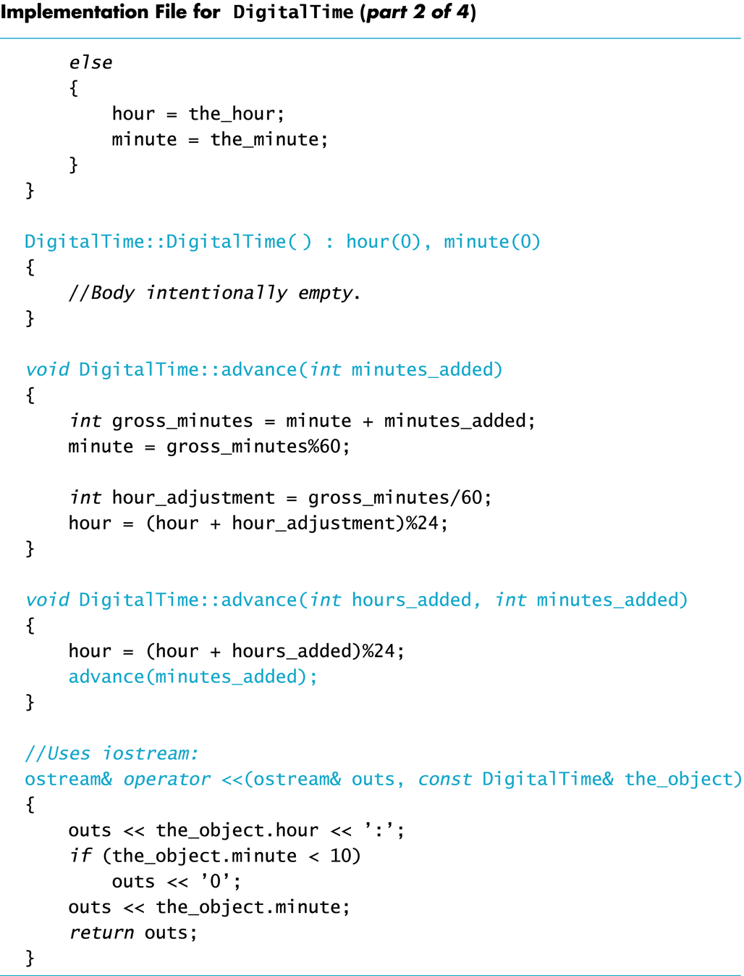
Display 2.2 (2/4)

Slide 19
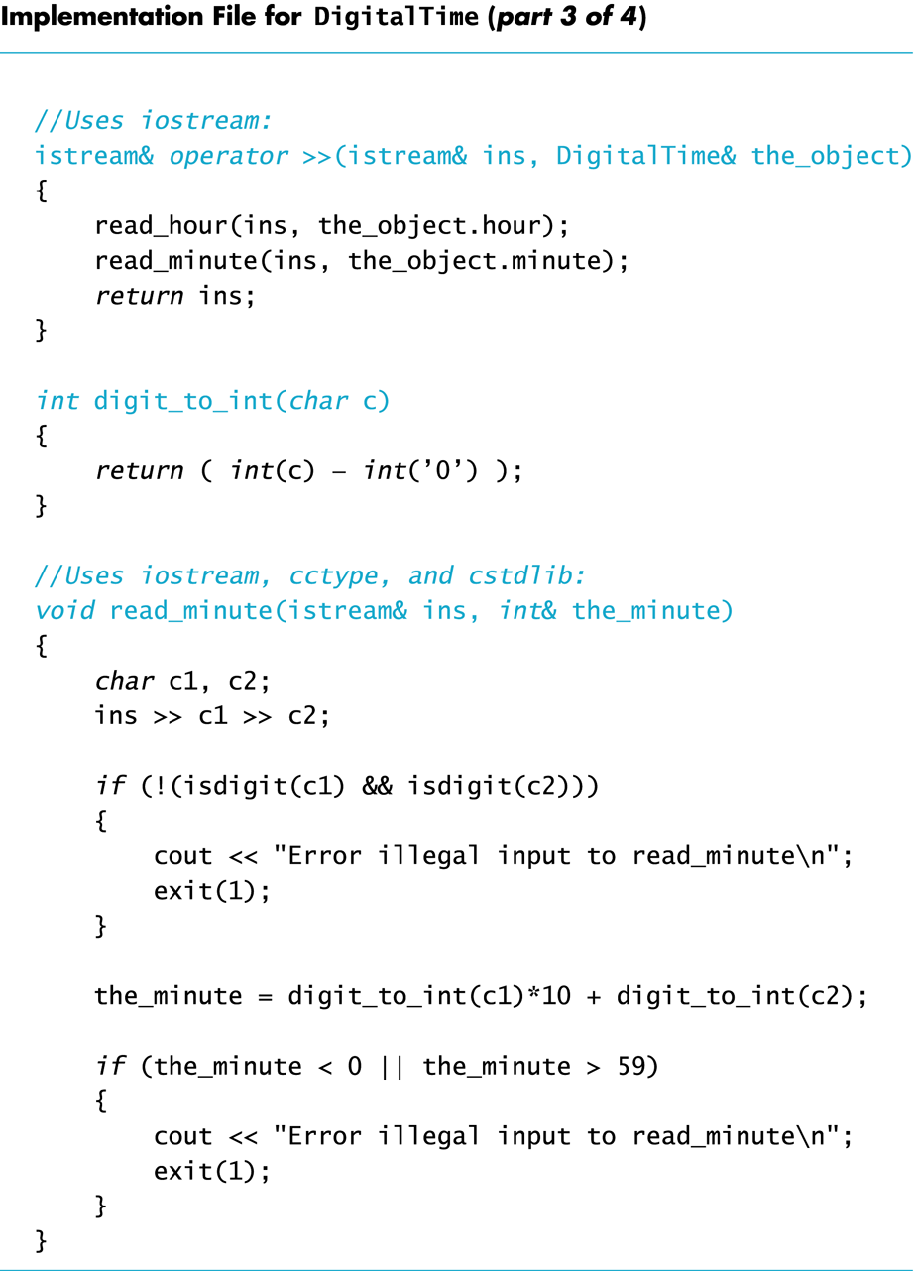
Display 12.2 (3/4)

Slide 20
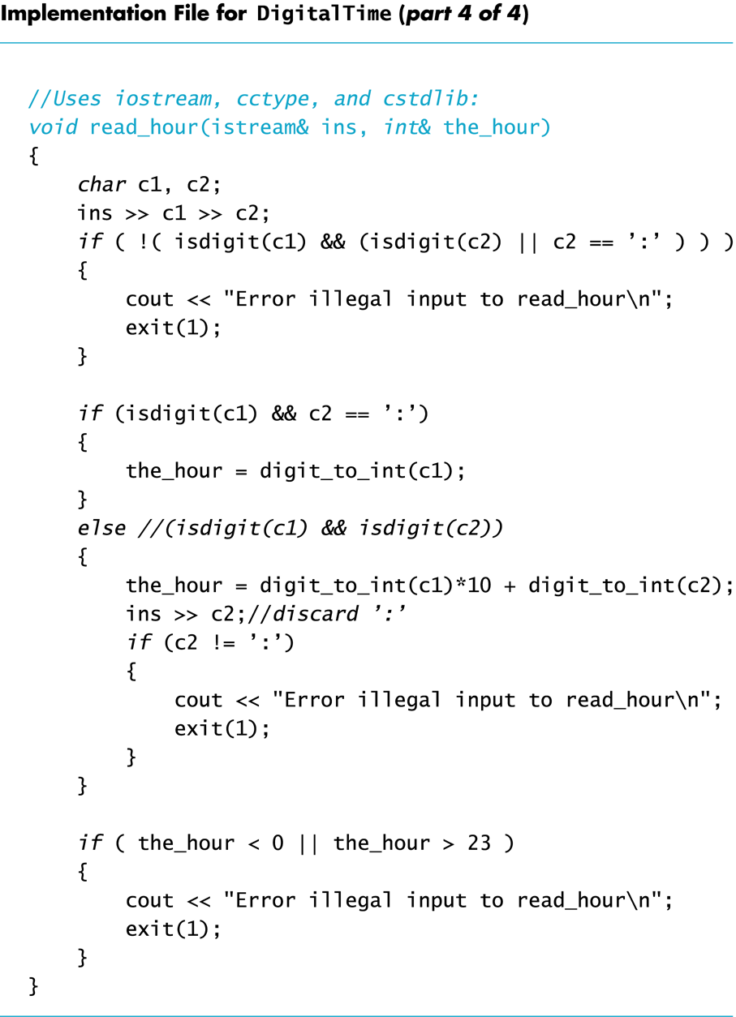
Display 12.2 (4/4)

Slide 21
The Application File
The Application file is the file that contains the program that uses the ADT
It is also called a driver file
Must use an include directive to include the interface file: #include "dtime.h"

Slide 22
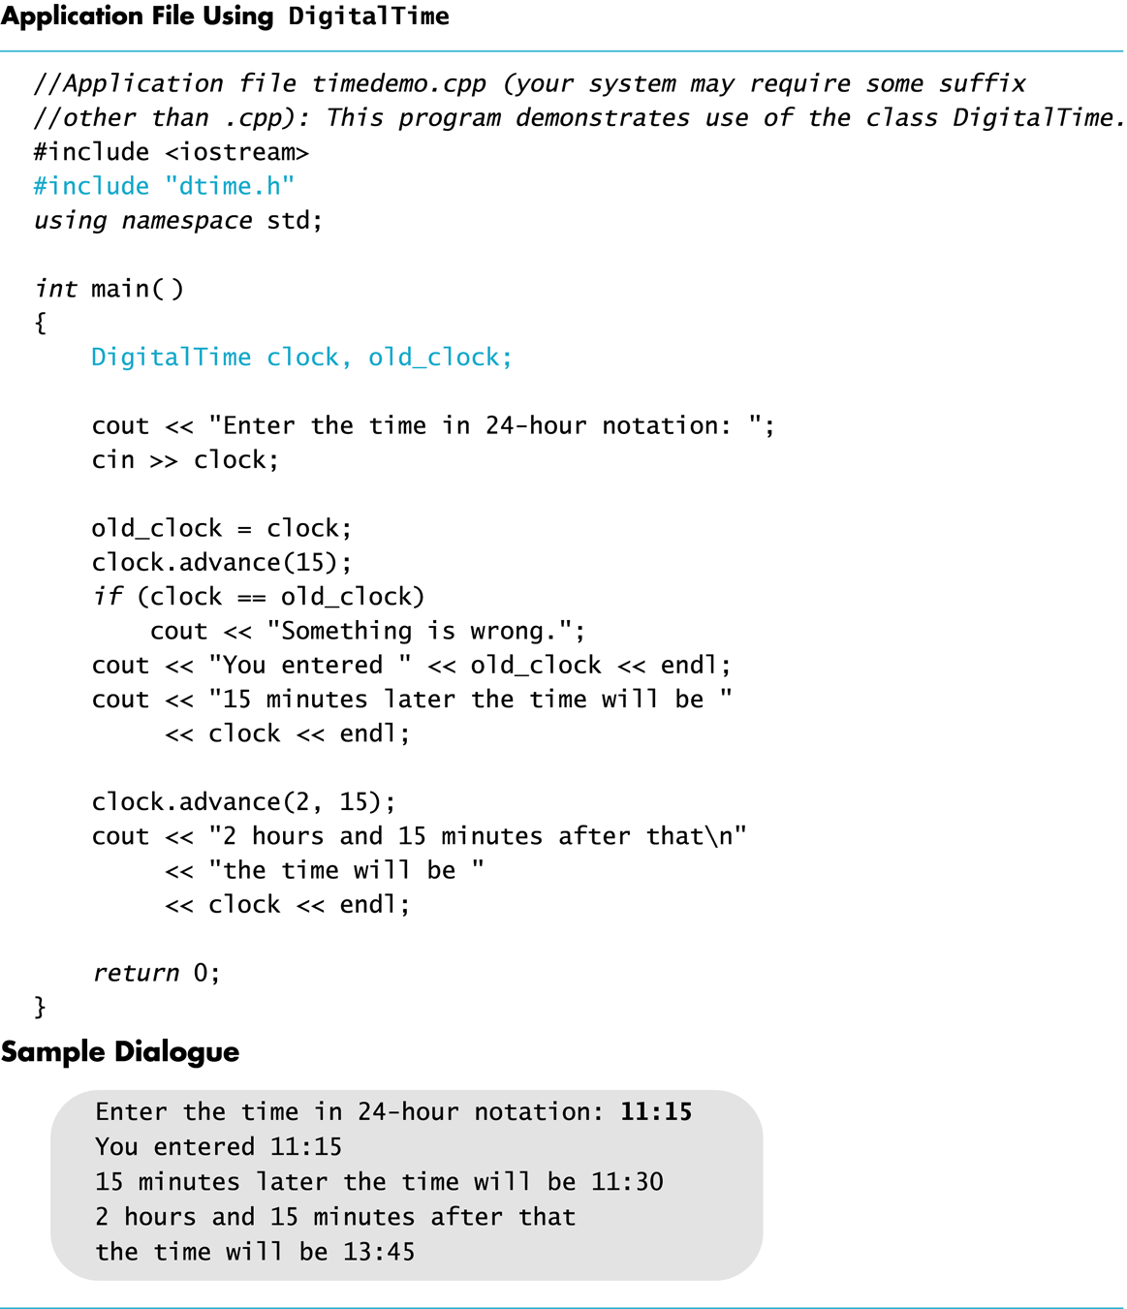
Display 12.3

Slide 23
Running The Program
Basic steps required to run a program: (Details vary from system to system!)
Compile the implementation file
Compile the application file
Link the files to create an executable program using a utility called a linker
Linking is often done automatically

Slide 24
Compile dtime.h ?
The interface file is not compiled separately
The preprocessor replaces any occurrence of #include "dtime.h" with the text of dtime.h before compiling
Both the implementation file and the application file contain #include "dtime.h"
The text of dtime.h is seen by the compiler in each of these files
There is no need to compile dtime.h separately

Slide 25
Why Three Files?
Using separate files permits
The ADT to be used in other programs without rewriting the definition of the class for each
Implementation file to be compiled once even if multiple programs use the ADT
Changing the implementation file does not require changing the program using the ADT

Slide 26
Reusable Components
An ADT coded in separate files can be used over and over
The reusability of such an ADT class
Saves effort since it does not need to be
Redesigned
Recoded
Retested
Is likely to result in more reliable components

Slide 27
Multiple Classes
A program may use several classes
Each could be stored in its own interface and implementation files
Some files can "include" other files, that include still others
It is possible that the same interface file could be included in multiple files
C++ does not allow multiple declarations of a class
The #ifndef directive can be used to prevent multiple declarations of a class

Slide 28
Introduction to #ifndef
To prevent multiple declarations of a class, we can use these directives:
#define DTIME_H adds DTIME_H to a list indicating DTIME_H has been seen
#ifndef DTIME_H checks to see if DTIME_H has been defined
#endif If DTIME_H has been defined, skip to #endif

Slide 29
Using #ifndef
Consider this code in the interface file
#ifndef DTIME_H #define DTIME_H < The DigitalTime class definition goes here> #endif
The first time a #include "dtime.h" is found, DTIME_H and the class are defined
The next time a #include "dtime.h" is found, all lines between #ifndef and #endif are skipped
true
false

Slide 30
Why DTIME_H?
DTIME_H is the normal convention for creating an identifier to use with ifndef
It is the file name in all caps
Use ' _ ' instead of ' . '
You may use any other identifier, but will make your code more difficult to read

Slide 31
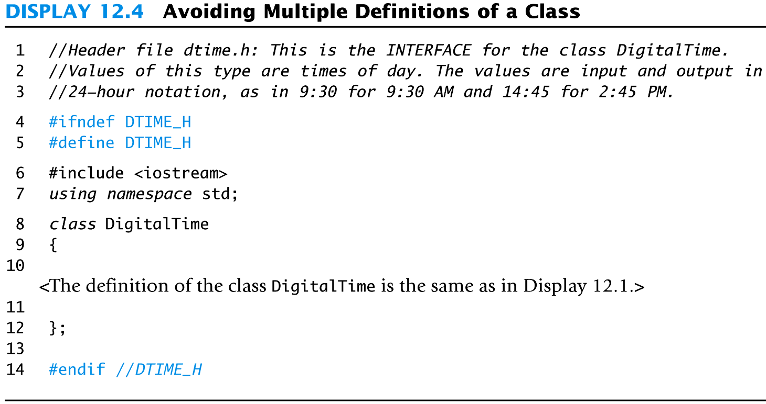
Display 12.4

Slide 32
Defining Libraries
You can create your own libraries of functions
You do not have to define a class to use separate files
If you have a collection of functions…
Declare them in a header file with their comments
Define them in an implementation file
Use the library files just as you use your class interface and implementation files

Slide 33
Section 12.1 Conclusion
Can you
Determine which belongs to the interface, implementation or application files?
Class definition
Declaration of a non-member function used as an operation of the ADT
Definition of a member function
The main part of the program
Describe the difference between a C++ class and an ADT?

Slide 34
12.2
Namespaces

Slide 35
Namespaces
A namespace is a collection of name definitions, such as class definitions and variable declarations
If a program uses classes and functions written by different programmers, it may be that the same name is used for different things
Namespaces help us deal with this problem

Slide 36
The Using Directive
#include <iostream> places names such as cin and cout in the std namespace
The program does not know about names in the std namespace until you add using namespace std; (if you do not use the std namespace, you can define cin and cout to behave differently)

Slide 37
The Global Namespace
Code you write is in a namespace
it is in the global namespace unless you specify a namespace
The global namespace does not require the using directive

Slide 38
Name Conflicts
If the same name is used in two namespaces
The namespaces cannot be used at the same time
Example: If my_function is defined in namespaces ns1 and ns2, the two versions of my_function could be used in one program by using local using directives this way:
{ using namespace ns1; my_function( ); }
{ using namespace ns2; my_function( ); }

Slide 39
Scope Rules For using
A block is a list of statements enclosed in { }s
The scope of a using directive is the block in which it appears
A using directive placed at the beginning of a file, outside any block, applies to the entire file

Slide 40
Creating a Namespace
To place code in a namespace
Use a namespace grouping
namespace Name_Space_Name { Some_Code }
To use the namespace created
Use the appropriate using directive
using namespace Name_Space_Name;

Slide 41
Namespaces: Declaring a Function
To add a function to a namespace
Declare the function in a namespace grouping namespace savitch1 { void greeting( ); }

Slide 42
Namespaces: Defining a Function
To define a function declared in a namespace
Define the function in a namespace grouping namespace savitch1 { void greeting( ) { cout << "Hello from namespace savitch1.\n"; } }

Slide 43
Namespaces: Using a Function
To use a function defined in a namespace
Include the using directive in the program where the namespace is to be used
Call the function as the function would normally be called int main( ) { { using namespace savitch1; greeting( ); }
Using directive's scope

Slide 44
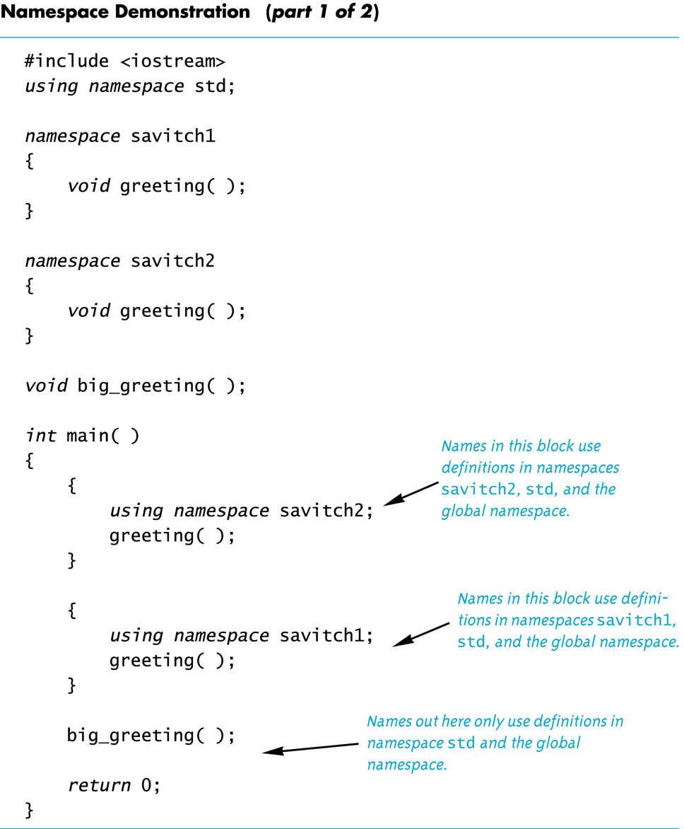
Display 12.5 (1/2)

Slide 45
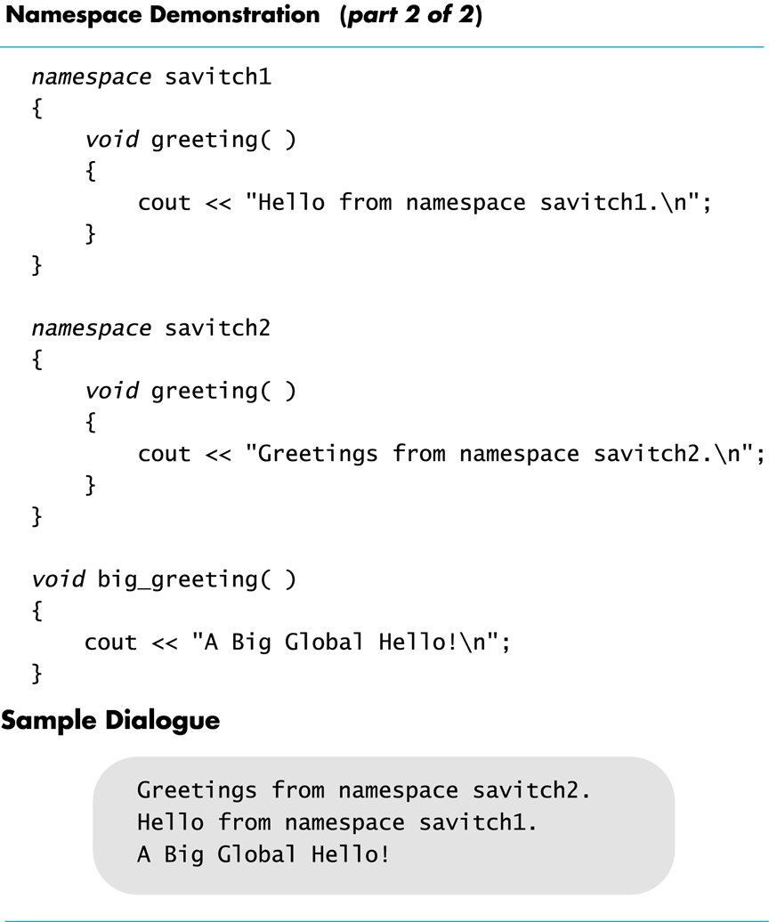
Display 12.5 (2/2)

Slide 46
A Namespace Problem
Suppose you have the namespaces below:
Is there an easier way to use both namespaces considering that my_function is in both?
namespace ns1 { fun1( ); my_function( ); }
namespace ns2 { fun2( ); my_function( ); }

Slide 47
Qualifying Names
Using declarations (not directives) allow us to select individual functions to use from namespaces
using ns1::fun1; //makes only fun1 in ns1 avail
The scope resolution operator identifies a namespace here
Means we are using only namespace ns1's version of fun1
If you only want to use the function once, call it like this ns1::fun1( );

Slide 48
Qualifiying Parameter Names
To qualify the type of a parameter with a using declaration
Use the namespace and the type name int get_number (std::istream input_stream) …
istream is the istream defined in namespace std
If istream is the only name needed from namespace std, then you do not need to use using namespace std;

Slide 49
Directive/Declaration (Optional)
A using declaration (using std::cout;) makes only one name available from the namespace
A using directive makes all the names in the namespace available

Slide 50
A Subtle Point (Optional)
A using directive potentially introduces a name
If ns1 and ns2 both define my_function, using namespace ns1; using namespace ns2; is OK, provided my_function is never used!

Slide 51
A Subtle Point Continued
A using declaration introduces a name into your code: no other use of the name can be made
using ns1::my_function; using ns2::my_function; is illegal, even if my_function is never used

Slide 52
Unnamed Namespaces
As we have done helper functions so far, they are not really hidden (Display 12.2)
We would like them to be local to the implementation file to implement information hiding
The unnamed namespace can hide helper functions
Names defined in the unnamed namespace are local to the compilation unit
A compilation unit is a file (such as an implementation file) plus any file(s) #included in the file

Slide 53
The unnamed grouping
Every compilation unit has an unnamed namespace
The namespace grouping is written as any other namespace, but no name is given: namespace { void sample_function( ) … } //unnamed namespace

Slide 54
Names In The unnamed namespace
Names in the unnamed namespace
Can be reused outside the compilation unit
Can be used in the compilation unit without a namespace qualifier
The rewritten version of the DigitalTime interface is found in while the implementation file is shown in

Slide 55
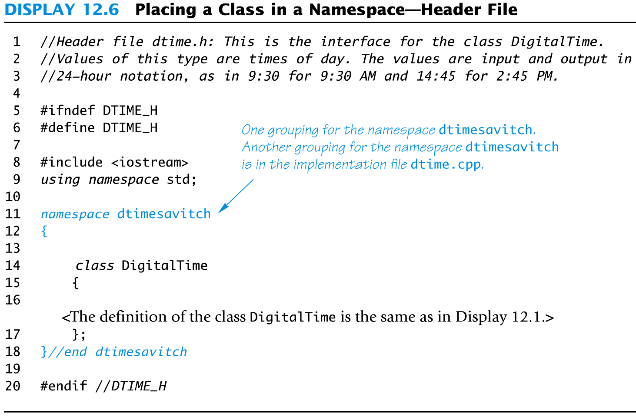
Display 12.6

Slide 56
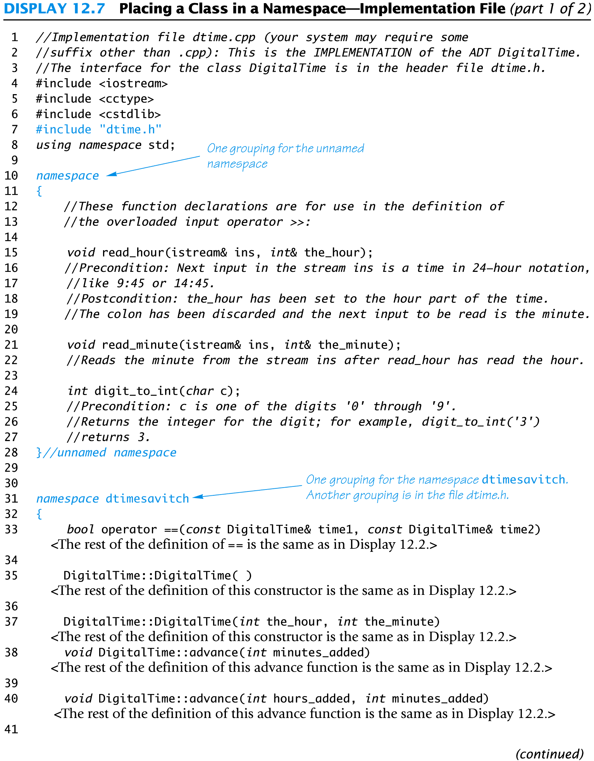
Display 12.7 (1/2)

Slide 57
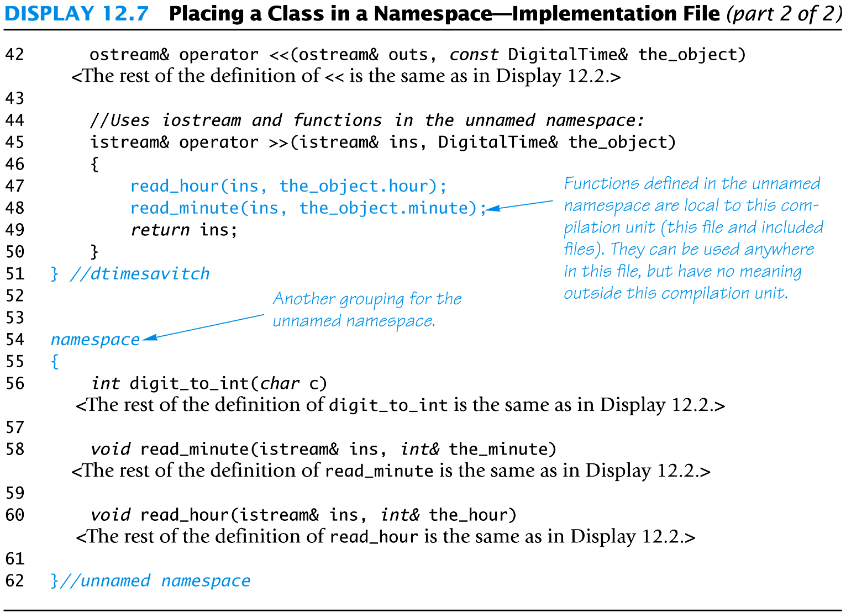
Display 12.7 (2/2)

Slide 58
Namespaces In An Application
The application file for the DigitalTime ADT is shown in

Slide 59
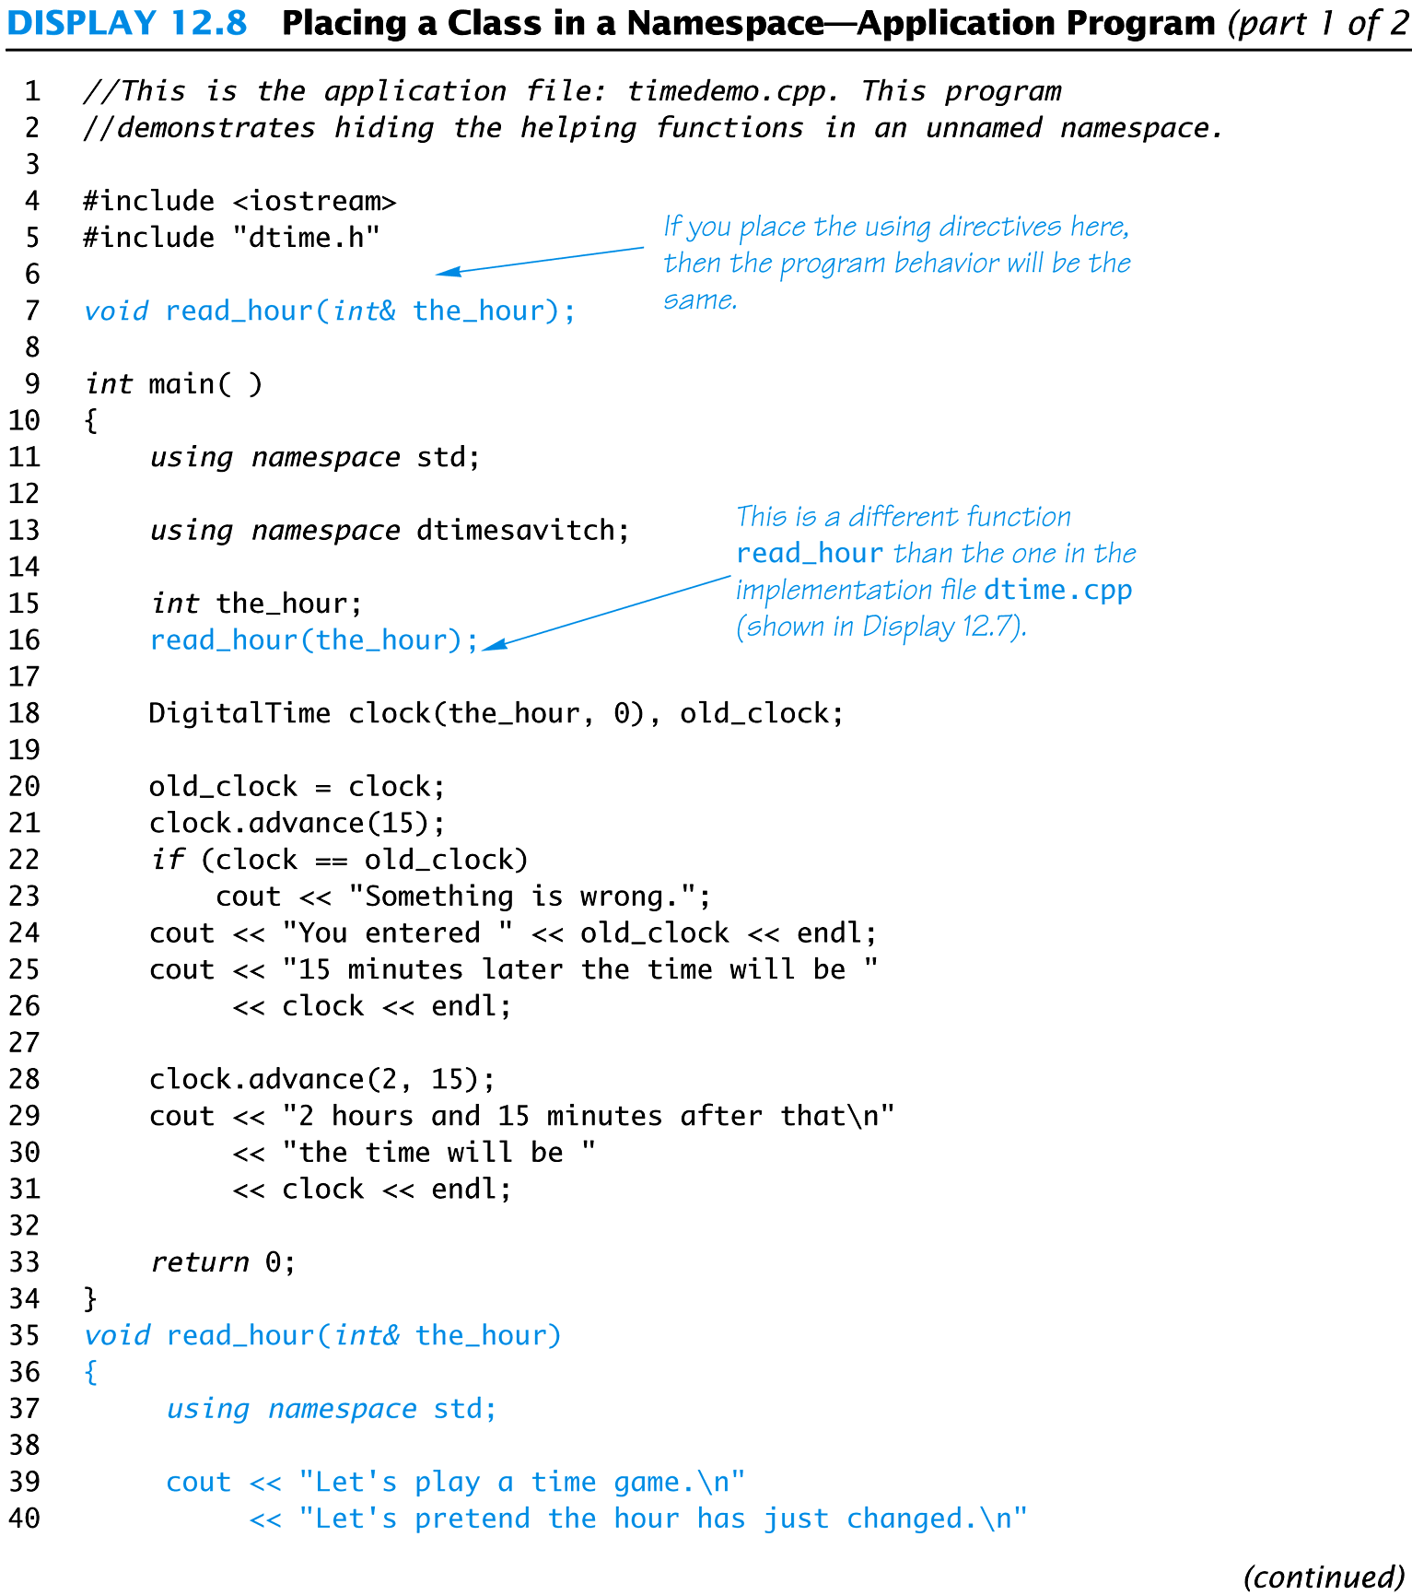
Display 12.8 (1/2)

Slide 60
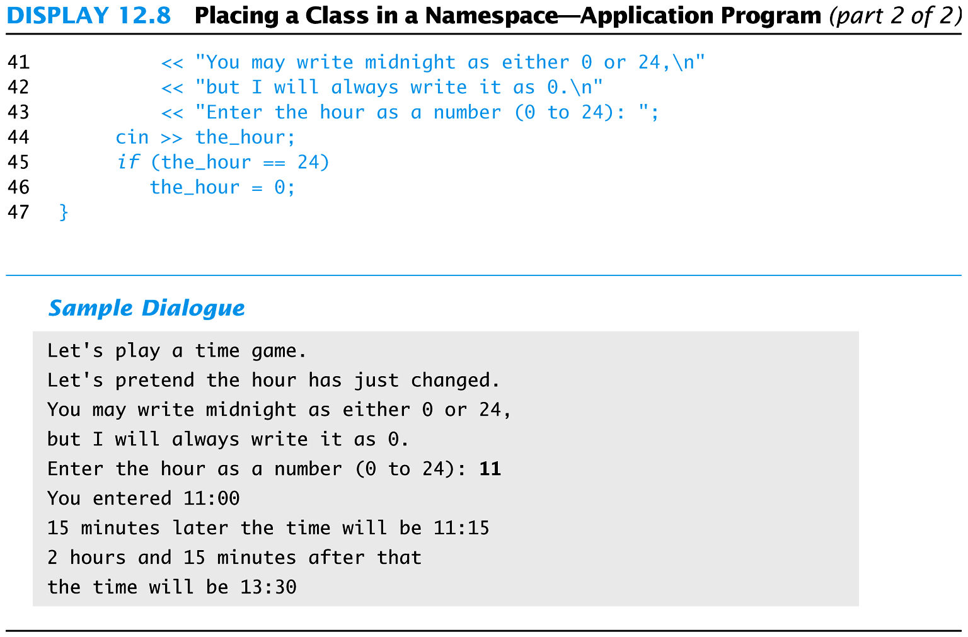
Display 12.8 (2/2)

Slide 61
Compilation Units Overlap
A header file is #included in two files
It is in two compilation units
Participates in two unnamed namespaces!
This is OK as long as each of the compilation units makes sense independent of the other
A name in the header file's unnamed namespace cannot be defined again in the unnamed namespace of the implementation or application file

Slide 62
Naming Namespaces
To avoid choosing a name for a namespace that has already been used
Add your last name to the name of the namespace
Or, use some other unique string

Slide 63
Global or unnamed?
Names in the global namespace have global scope (all files)
They are available without a qualifier to all the program files
Names in the unnamed namespace are local to a compilation unit
They are available without a qualifier within the compilation unit

Slide 64
Section 12.2 Conclusion
Can you
Explain the purpose of using interface and implementation files?
Describe a namespace?
Demonstrate three ways to use the names in a namespace?

Slide 65
Chapter 12 -- End

